Slide 1

By Paola, Jonathan, Abiy, Charles, and Mark

Slide 2
An Awesome Tool to Plan Retirement
A great software simulator to help the general public plan for retirement
Investor is asked a series of questions about their current savings situation and goals
Application models out a retirement scenario

Slide 3
User is asked a series of profile questions
Portfolio Value
Desired retirement date
Risk Tolerance

Slide 4
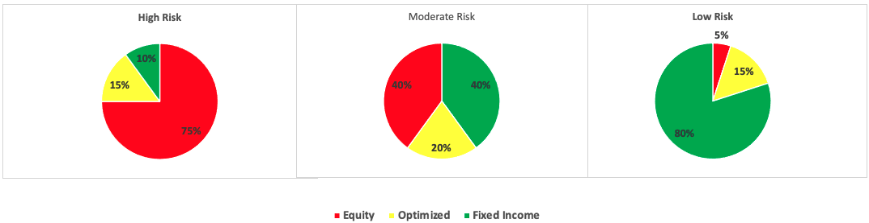
Optimization: Maximize Sharpe Ratio
Given the user risk profile (high, moderate, low risk)
We optimize allocation in individual securities
Data inputs: Alpaca API, data from 2008.
Optimization function used: minimize from scipy.optimize

Slide 5
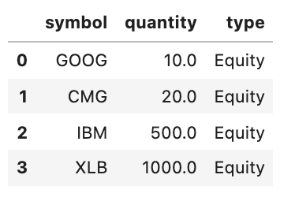
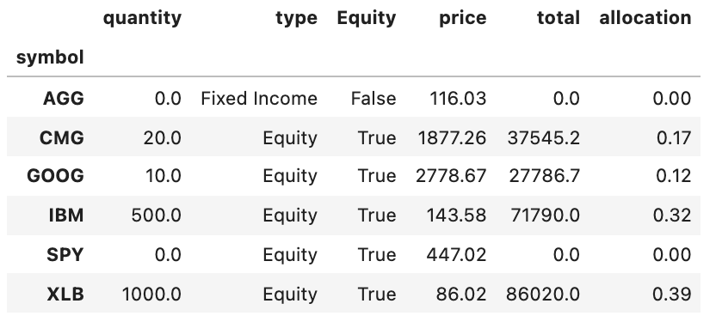
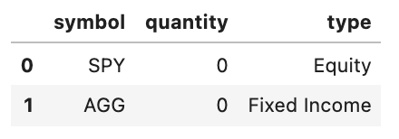
Optimization steps sample
Look for the combination of weights which maximizes Sharpe Ratio subject to Equity restrictions
Initial Portfolio
Diversification addition

Slide 6
Initial versus optimized allocation
AGG : iShares Core US Aggregate Bond ETF
CMG : Chipotle Mexican Grill Inc.
GOOG: Alphabet Inc. Class C
IBM : IBM Common Stock
XLB : Materials Select Sector SPDR Fund
SPY : SPDR S&P 500 ETF Trust

Slide 7
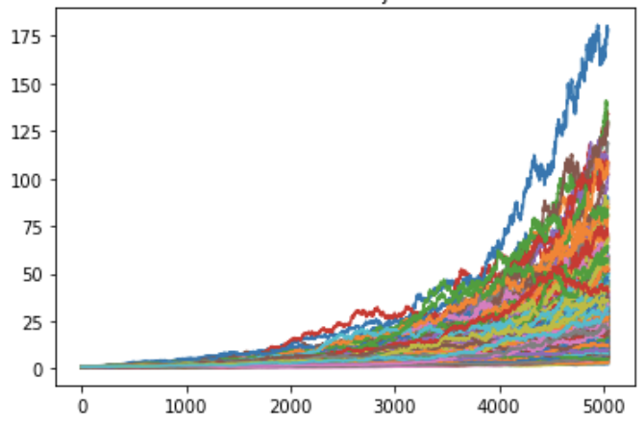
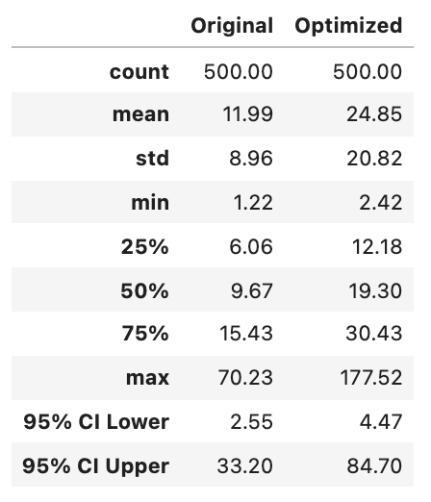
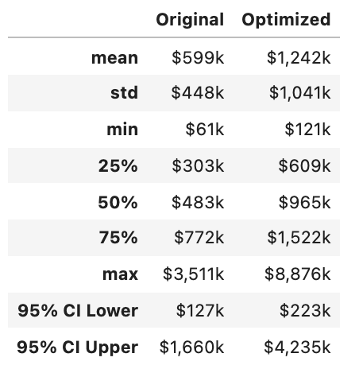
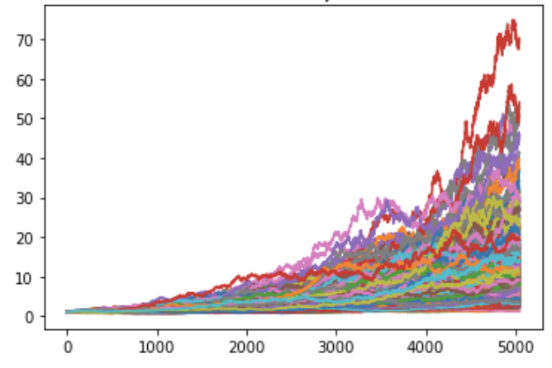
Montecarlo Simulation results
500 Simulations
Over 20 years
500 Simulated Trajectories over 5040 Trading Days
Initial Investment:
$50,000.-
High Risk Profile
Simulation
Summary Statistics
Optimized portfolio
Original portfolio

Slide 8
V2 – Next Steps

